Slide 1


INTELLIGENT FARMING MANAGEMENT USING IOT
K.RAMAKRISHNAN COLLEGE OF ENGINEERING
(Autonomous)
Accredited by NAAC with - 'A' Grade, NBA Accreditation of EEE
DEPARTMENT OF ELECTRICAL AND ELECTRONICS ENGINEERING
BATCH No : 12
GUIDED BY
Mr.T.VADIVELAN M.E.,
ASSISTANT PROFESSOR.
Electrical and Electronics Engineering
K.Ramakrishnan College of Engineering,
(Autonomous)
Samayapuram, Tiruchirappalli – 621 112

Slide 2
INTELLIGENT FARMING MANAGEMENT USING IOT
PRESENTED BY
JEGAN.R (EE2119)
KARTHIKEYAN.M(EE2122)
MOHAMED ASIF.M(EE2128)
MOHAMED IBRAHIM KALIFULLAH.K.M(LEE2159)
Department of Electrical and Electronics Engineering
(Accredited by NBA)
B.E, 6th SEM
K.RAMAKRISHNAN COLLEGE OF ENGINEERING
(Autonomous)

Slide 3
WHAT WE WILL COVER
INTRODUCTION
LITERATURE SURVEY
METHODOLOGY
RESULT
CONCLUSION
FUTURE SCOPE
REFERENCES

Slide 4
Introduction
Village equipped with all the modern technology without destroying the nature can be defined as smart village.
The system consists of centralized microprocessor interfaced with many sensors for making the villages cleaner and smarter
To sense the soil, a soil moisture sensor is used. Soil moisture sensors measure the volumetric water content in soil
It measure the volumetric water content indirectly by using some other property of the soil, such as electrical resistance, dielectric constant, or interaction with neutrons, as a proxy for the moisture content

Slide 5
LITERATURE SURVEY
In this paper ,we are studied about the agriculture field is one of the most crucial aspects of countries with enormous populations, fertile land and water resources. Incorporation of smart irrigation will go a long way in enabling the countries to effectively and efficiently use the available water, further using the extra water for the barren lands. In this paper, an IoT-based smart irrigation system is used for building a smart Management device that efficiently uses the available water.
The purpose of this Management device is to automatically manage time, avoid under-irrigation and over-irrigation issues, streamline water consumption, distribution and manage the water reserves.

Slide 6
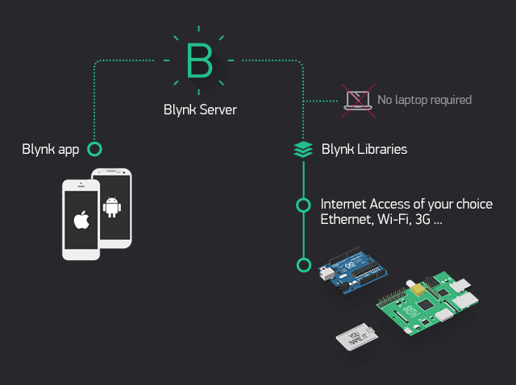
Methodology
This work will be developed The Smart Village concept, Solar Based Smart Agriculture With IoT Enabled For Climatic Change And Fertilization Of Soil integrates with Internet of things (IOT) which is a revamping the agri-business engaging the farmers by the broad assortment of techniques, for instance, accuracy and conservative cultivation to go up against challenges in the field.

Slide 7
IOT advancement aids in social affair information on conditions like atmosphere,temperature and productivity of soil, nutrients in the soil, level of water into the field of cultivation.
Use Of Wireless sensor Networks In Precision Agriculture In this project As its name suggests, Precision Agriculture is exact in both the extent of the product territory it screens and in addition in the conveyance measures of water, compost, and so forth.
This innovation can separate a solitary plant for checking in the tens or several square feet.

Slide 8
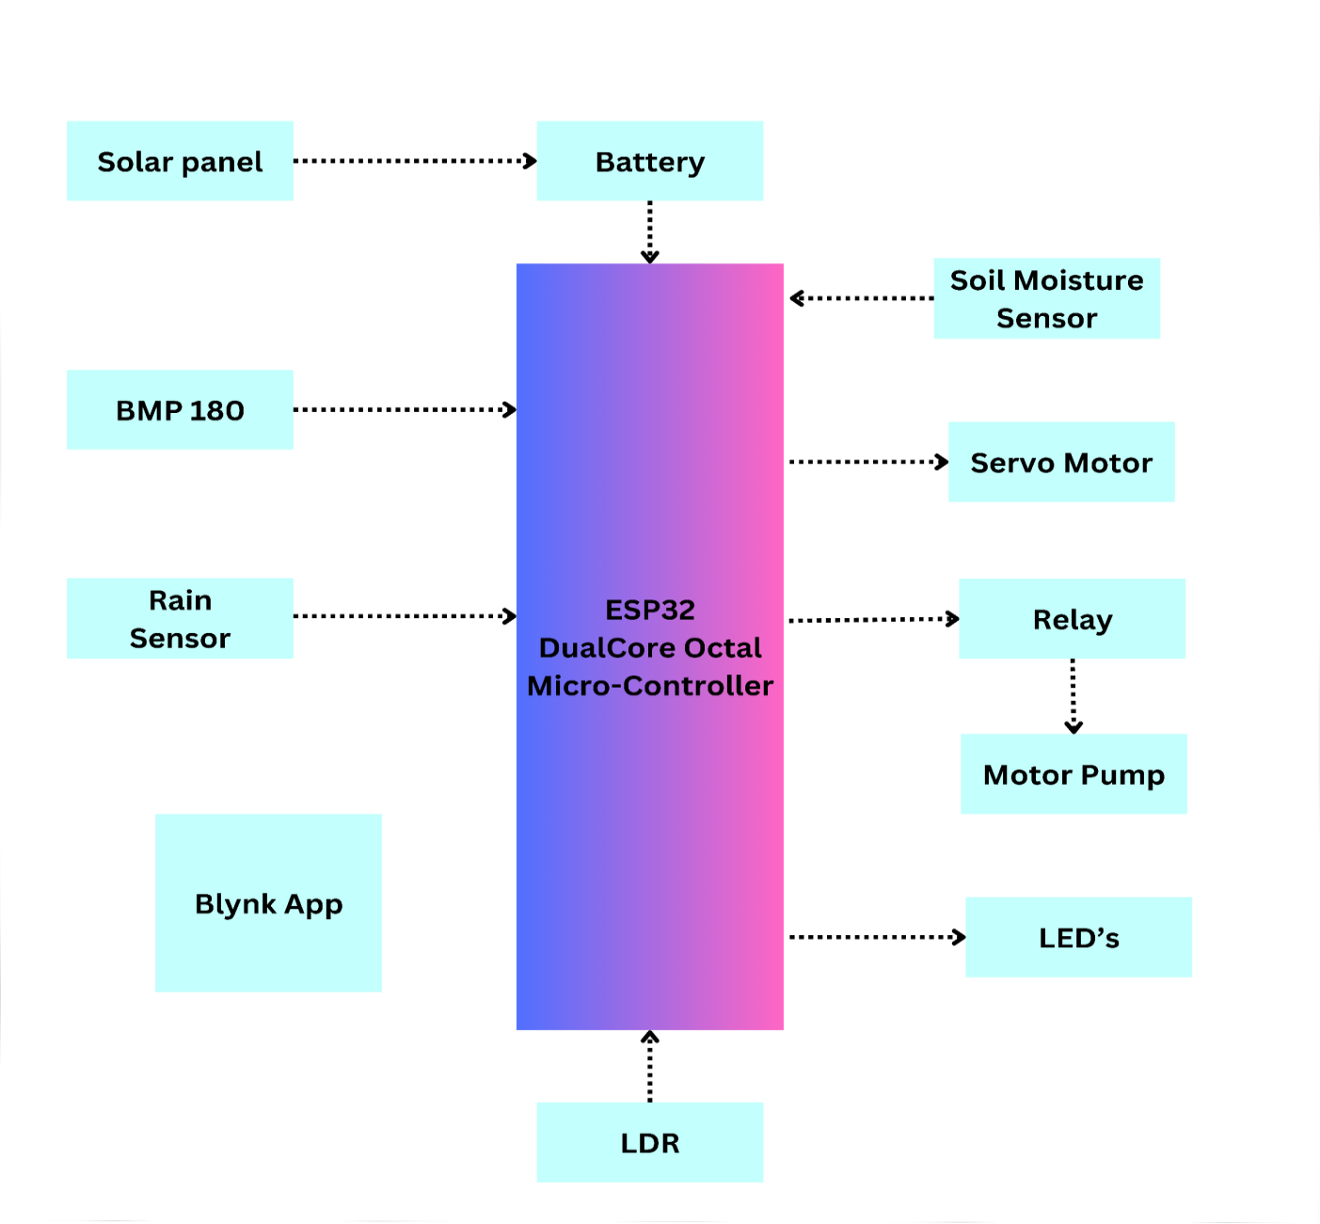
BLOCK DIAGRAM

Slide 9
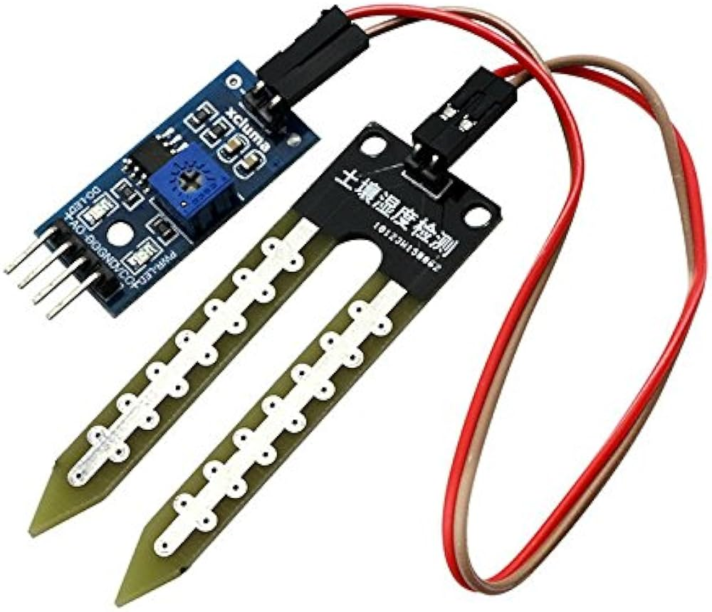
Soil moisture sensor
Soil moisture sensors measure or estimate the amount of water in the soil
Copper electrodes are used to sense the moisture content of soil.
The Soil Moisture Sensor uses capacitance to measure dielectric permittivity of the surrounding medium In soil, dielectric permittivity is a function of the water content

Slide 10
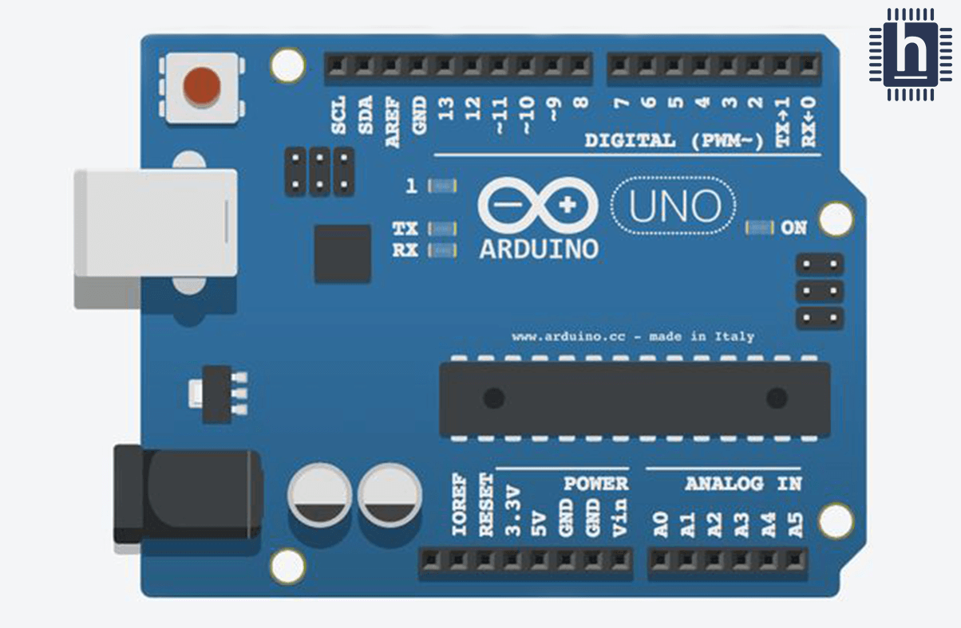
Arduino UNO
The Arduino Uno board is a microcontroller based on the ATmega328.
It has 14 digital input and output pins (of which 6 can provide PWM output),6 analog inputs, a USB connector, a power jack and reset button
The operating voltage is 5 volts.

Slide 11
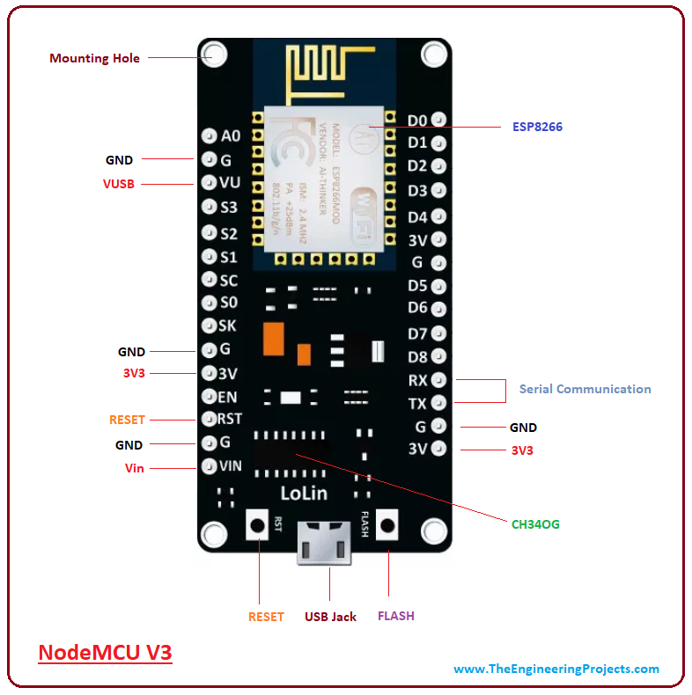
Node MCU V3
The module is mainly based on ESP8266 that is a low-cost Wi-Fi microchip incorporating both a full TCP/IP stack and microcontroller capability.
This is where Node MCU V3 comes handy that incorporates a built-in Wi-Fi support, giving an easy pathway to design IoT applications as per your technical requirements.
Node MCU V3 is an open-source firmware and development kit that plays a vital role in designing your own IoT product using a few Lua script lines.

Slide 12
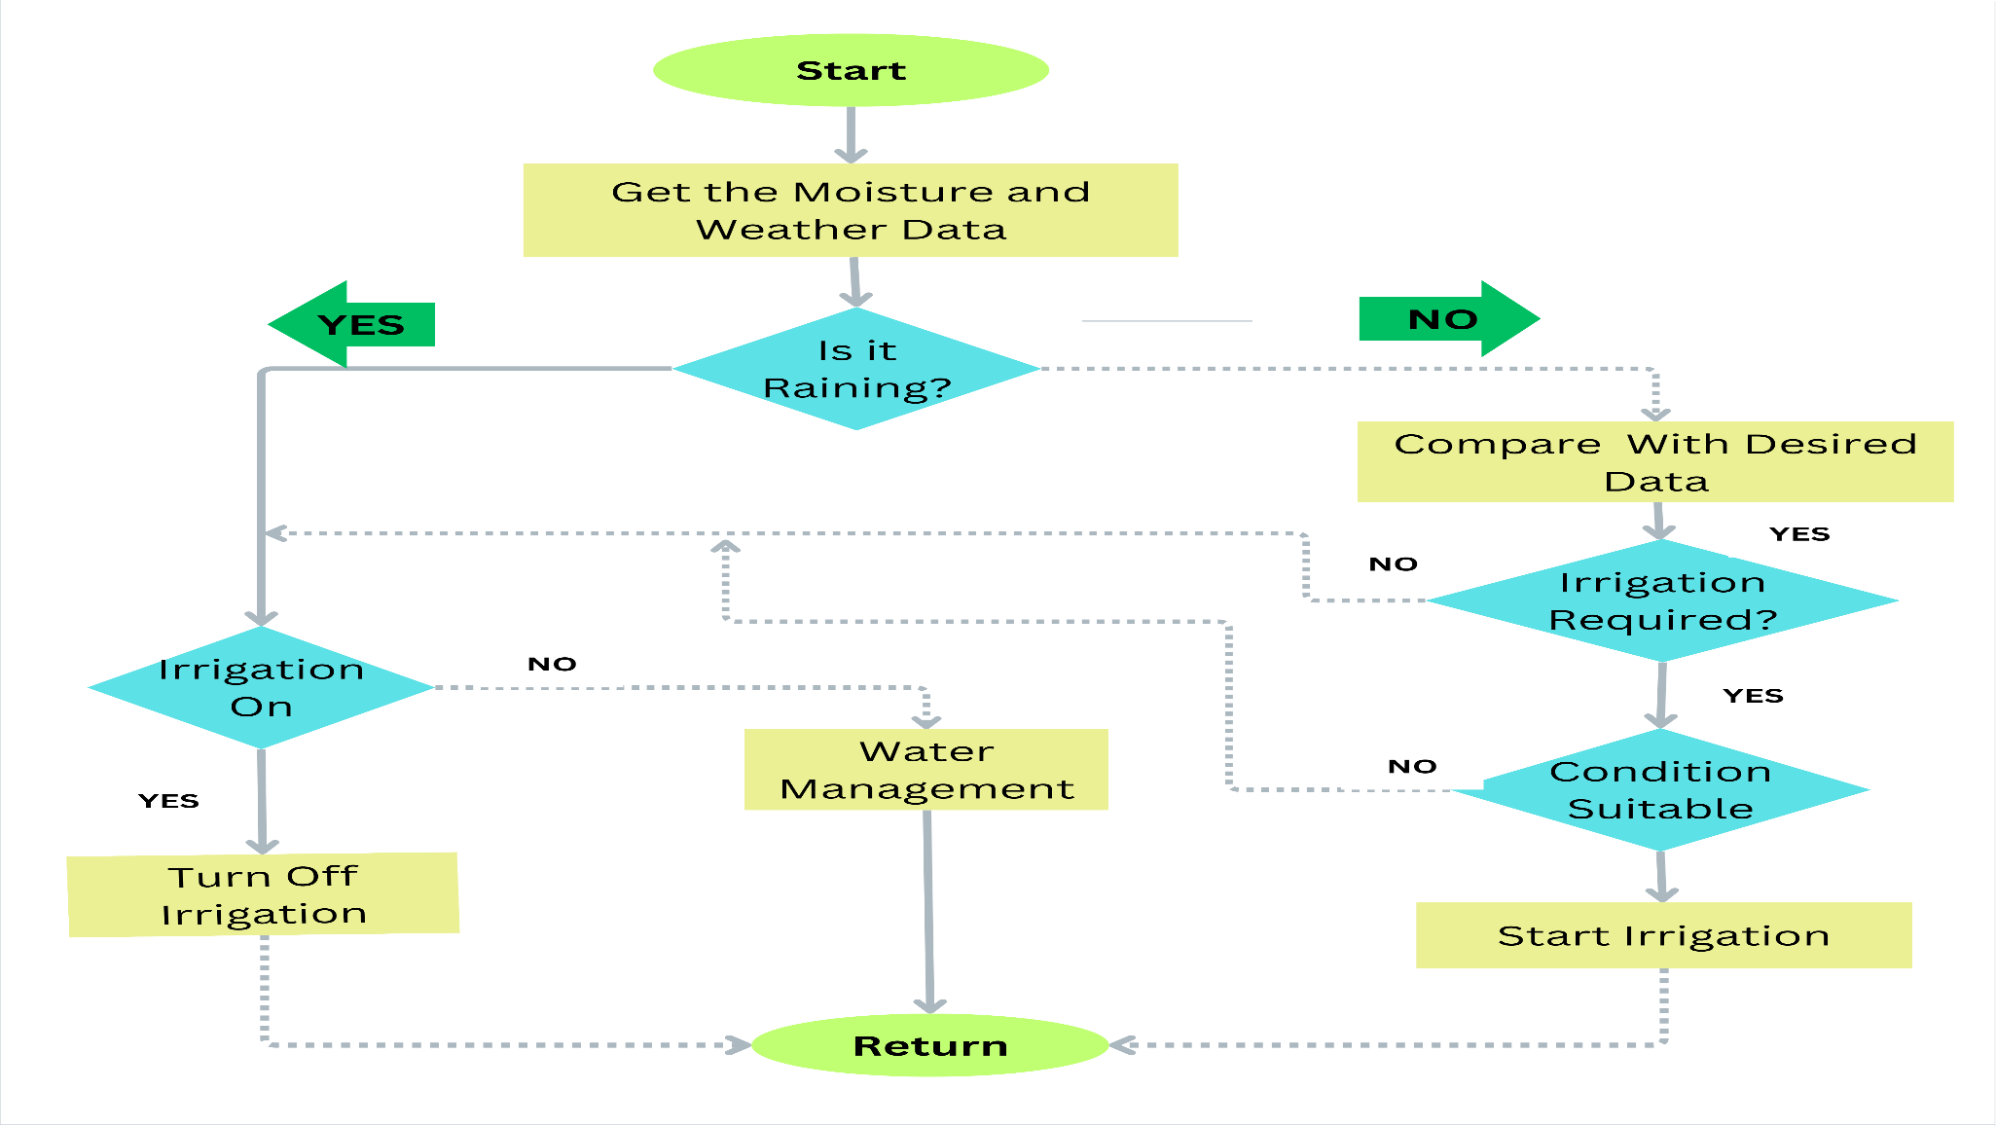
Flowchart

Slide 13
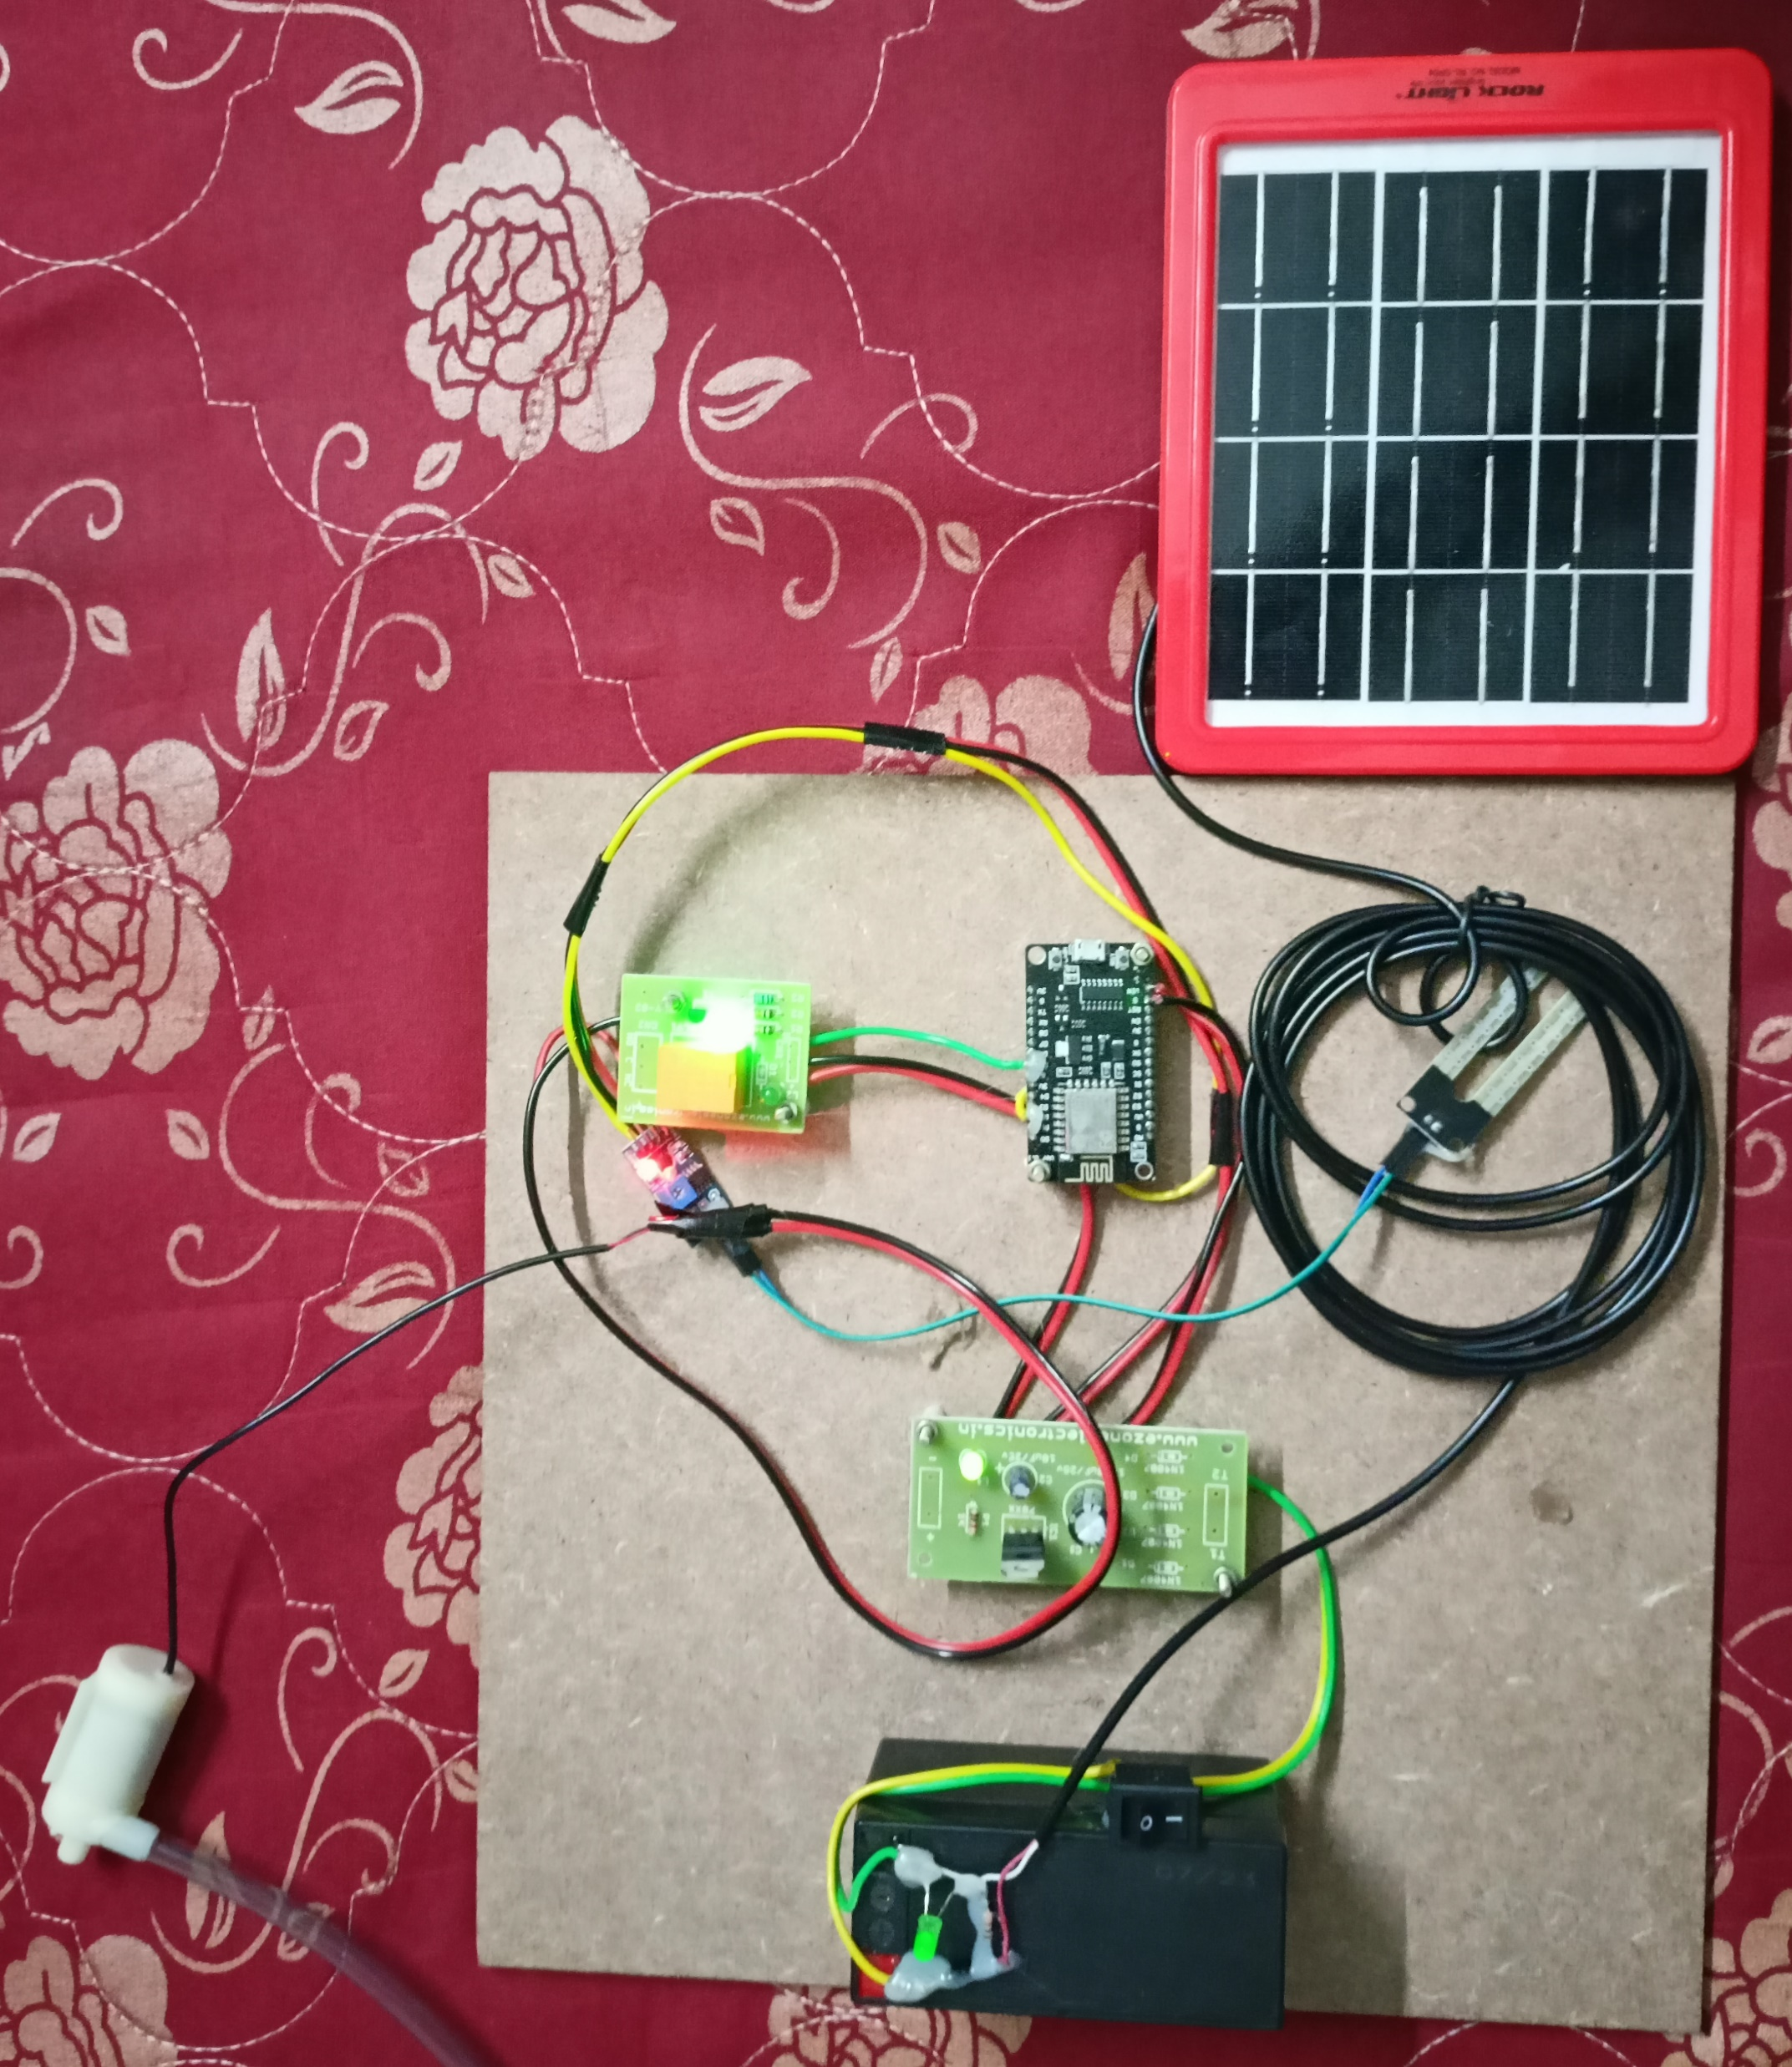
Connection of entire project kit

Slide 14
RESULT
The working of system is that it will collect real data from different sensors connected to the system regarding to moisture and weather condition and check about rain.
If the desired data is not match with collected data then identified whether it required irrigation or not level is low Now if it required the irrigation, turning on the pump and checking the actual data with desired data after some finite interval.
If data is match, the system will stop irrigation by turning off pump. In rainy day most of time irrigation is not needed but in winter most of time system will turn on and off the irrigation.
While in summer it required more water so most of time system is on.

Slide 15
CONCLUSION
A Intelligent farming is best system that can help to detect,measure and control the amount of water in the soil accurately because it uses sensors that can detect the plant’s water needs and satisfy them.
The system is basically to control the amount of water that is supplied to the plants and to ensure each plant has enough water and to protect plants from dying by using a humidity sensor, a temperature sensor, a moister sensor and a timer using renewable energy PV system
The device will work as a control system and sense the rate of water, temperature and humidity of plants as well as to detect whether the plants are dry or how much of water is needed

Slide 16
FUTURE SCOPE
• Sensors like fire detection sensor can be added to safe guard the yield by any fire accidents.
• To avoid top soil erosion, addition of rain gun device can be added to sprinkle the water.
• This system can be developed by using renewable energy which is solar power to run the “single board computer (SBC)”
i.e. raspberry pi, using solar energy will help to reduce future cost.

Slide 17
References
Immanuel ion Ramdinthara, Dr. P Shanthi Bala, Asst. Prof., A Comparative study of IoT Technology in Precision Agriculture, IEEE 2019.
Jia Uddin, S.M. Taslim Reza, Qader Newaz, Jamal Uddin, Touhidul Islam, and Jong MyonKim, “Automated Irrigation System Using Solar Power” IEEE 2012
onlinehttp://raspberrypi.org
online: www.electronichub.com

Slide 18
Chakraborty, 2020J. ChakrabortyAnalog Sensors Vs. Digital Sensors (2020)
https://iot4beginners.com/analog-sensors-vs-digital-sensors/
Fatima et al., 2021N. Fatima, S.A. Siddiqui, A. Ahmad
IoT-based Smart Greenhouse with Disease Prediction using Deep Learning
International Journal of Advanced Computer Science and Applications, 12 (7) (2021), 10.14569/IJACSA.2021.0120713
View at publisher
Google Scholar

Slide 19
THANK YOU

